Slide 1
Developing Web Applications
JavaScript Introduction

Slide 2
What’s wrong with HTML?

Slide 3
Dynamic Web Pages
Static Web page
Page content established at the time page is created.
Useful for displaying data that doesn’t change often, and for navigating between HTML Web page files.
Dynamic Web page
Also called an interactive Web page.
Page content varies according to user requests or inputs.

Slide 4
Scripting Languages
Client side
JavaScript
VBScript (outdated, only IE)
Dart (created by Google to replace JavaScript/ compiles into JavaScript)
CoffeeScript (compiles into JavaScript)
Server side
PHP (Apache, IIS)
PERL
Python (Apache)
JavaScript (node.js)

Slide 5
JavaScript
Can be added to standard HTML Web pages using special HTML tags.
JavaScript® is the Netscape-developed object scripting language used in millions of web pages and server applications worldwide.
Netscape's JavaScript is a superset of the ECMA-262 Edition 3 (ECMAScript) standard scripting language, with only mild differences from the published standard.

Slide 6
JavaScript
Used for:
Data validation in forms
Creating pop-up browser windows
Animations, games, dynamic graphics
Manipulate layout on pages
Request data server side
Handling data like XML and JSON
Accessing API’s (think “HTML5”)

Slide 7
JavaScript
Autumn 2014
Implementations in browsers:
Spidermonkey (Firefox)
V8 (Google Chrome and Opera)
Chakra (Internet Explorer)
JavaScriptCore (SquirrelFish/Nitro) (WebKit browsers)

Slide 8
JavaScript is not Java
Interpreted (not compiled) by client.
Object-based, not object-oriented. Uses built-in, extensible objects, but no classes or inheritance.
Code integrated with, and embedded into, HTML.
Variable data types not declared (loose typing).
Dynamic binding. Object references checked at runtime.

Slide 9
Scripted languages are interpreted…
Scripting Languages
Executed by an interpreter contained within the web browser (scripting host)
Interpreter uses a scripting engine
Converts code to executable format each time it runs
Converted when browser loads web document

Slide 10
Programming in JavaScript

Slide 11
Types of errors in JavaScript
Logic and Debugging
Syntax
Rules of the language
Misuse of syntax
e.g., typing fer instead of for
Logic
Order of execution of various parts of the program
Unintended operation of program
e.g., Infinite loop

Slide 12
Where to put your script
JavaScript programs can be used in three ways:
Incorporated directly into an HTML file
Using <script> tag
Placed in an external (source) file
Has file extension .js
Contains only JavaScript statements
As value on a event attribute
<body onload=“”>

Slide 13
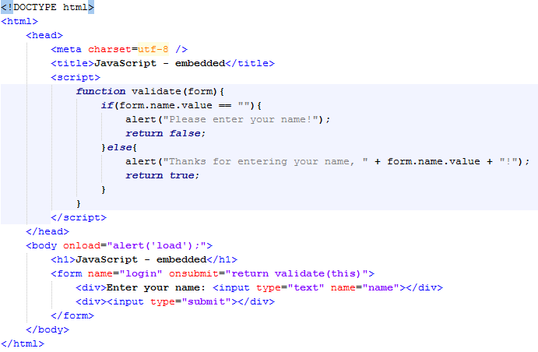
Embedded in HTML

Slide 14
Creating a JavaScript Source File
JavaScript source files
Use src attribute of <script> tag to denote source of JavaScript statements
Browser will ignore any JavaScript statements inside <script> and </script> if src attribute is used
Cannot include HTML tags in source file
<script type=“text/javascript” src=“source.js”></script>

Slide 15
Advantages of a JS Source File
Makes HTML document neater (less confusing)
JS can be shared among multiple HTML files
Hides JavaScript code from incompatible browsers
Can use a combination of embedded and non–embedded code
Allows finer granularity in coding functionality
JavaScript sections executed in order of location within HTML document

Slide 16
A First JavaScript Program
The <script> Tag
Document object
Considered a top-level object
Naming convention
Capitalize first letter of object
Unlike HTML, JavaScript is case sensitive

Slide 17
The <script> Tag
type attribute
If the language is not that described by "text/javascript", then the type attribute must be present.
Whatever language is used, the contents of the script element must conform with the requirements of that language's specification.

Slide 18
Where to put the embedded script
Placing JavaScript in <head> or <body> sections.
Script statements interpreted in order of document rendering
<head> section rendered before <body> section
Good practice to place as much code as possible in <head> section

Slide 19
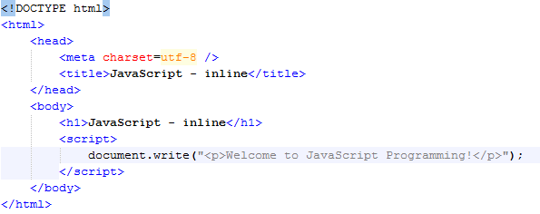
Inline JavaScript

Slide 20
Document object
Represents the content of a browser’s window
write() & writeln() methods of Document object
Creates new text on a web page
Called by appending method to object with a period
Methods accept arguments
Information passed to a method

Slide 21
Variables
Example, declaring variables within a Script:
Example, initializing variables within a Script:
var variable1;
var variable2, variable3;
variable1 = 0;
variable2 = “Hello”;

Slide 22
Comments in JavaScript
Non-printing lines that are placed in the code to contain various remarks about the code
Makes it easier to understand the code operation
Two types
Line comments
// ignore all text to the end of the line
Block comments
/* ignore all text between these symbols */

Slide 23
Hiding JavaScript from Incompatible Browsers
Two methods
Place JavaScript in external source file
Enclose the code within HTML comments
<!-- beginning of HTML block comment end of HTML block comments -->
Alternate message display
If browser doesn’t support JavaScript
Use <noscript> & </noscript> to place alternate message to users of back-level browsers

Slide 24

Arrays
Array
An ordered collection of values referenced by a single variable name.

Slide 25
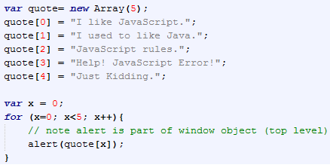
Arrays

Slide 26

Maths
You can easily add, subtract, multiply, divide and find the modulus

Slide 27

Maths
Precedence of arithmetic operators
Multiplication, Division and Modulus operators have highest precedence
Then comes Addition and Subtraction
This can be over-ridden using parentheses

Slide 28
JavaScript Operators
Some of the common JavaScript Operators include :
> | greater than
< | less than
== | equal to
!= | not equal to
|| | or
+= | a string variable concatenator (str+="a" same as str=str+"a"), a numeric variable adder (x+=y is the same as x=x+y)
x++ | increment x
x-- | decrement x

Slide 29
All languages have mechanisms for:
Sequence
Repetition
Selection

Slide 30
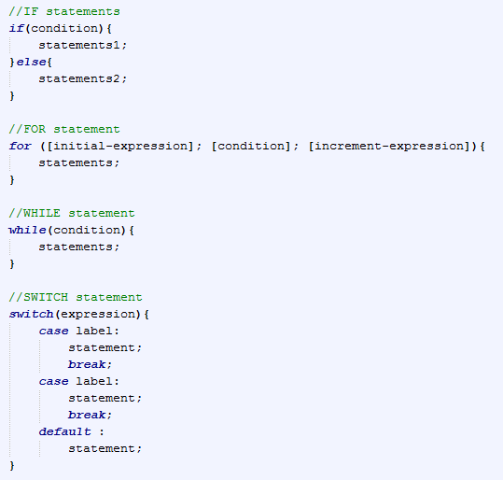
The structure of the major JavaScript Statements is basically the same as ‘C’.

Slide 31

Functions
JavaScript, like a lot of programming languages, uses functions.
The basic format is :

Slide 32
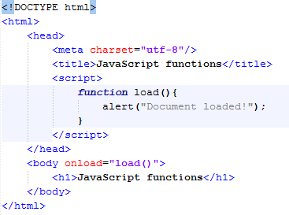
Functions

Slide 33

Functions
Parameters

Slide 34
Functions
Built-in functions, like:
eval( str )
parseFloat( str )
parseInt( str, radix )
unEscape( str )

Slide 35
Events
JavaScript and a few other script based languages could be described as event driven.
Events are built into the HTML code.

Slide 36
Events
Attribute | The event occurs when... | IE | F | O | W3C
onblur | An element loses focus | 3 | 1 | 9 | Yes
onchange | The content of a field changes | 3 | 1 | 9 | Yes
onclick | Mouse clicks an object | 3 | 1 | 9 | Yes
ondblclick | Mouse double-clicks an object | 4 | 1 | 9 | Yes
onerror | An error occurs when loading a document or an image | 4 | 1 | 9 | Yes
onfocus | An element gets focus | 3 | 1 | 9 | Yes
onkeydown | A keyboard key is pressed | 3 | 1 | No | Yes
onkeypress | A keyboard key is pressed or held down | 3 | 1 | 9 | Yes
onkeyup | A keyboard key is released | 3 | 1 | 9 | Yes
onload | A page or image is finished loading | 3 | 1 | 9 | Yes
onmousedown | A mouse button is pressed | 4 | 1 | 9 | Yes
onmousemove | The mouse is moved | 3 | 1 | 9 | Yes
onmouseout | The mouse is moved off an element | 4 | 1 | 9 | Yes
onmouseover | The mouse is moved over an element | 3 | 1 | 9 | Yes
onmouseup | A mouse button is released | 4 | 1 | 9 | Yes
onresize | A window or frame is resized | 4 | 1 | 9 | Yes
onselect | Text is selected | 3 | 1 | 9 | Yes
onunload | The user exits the page | 3 | 1 | 9 | Yes

